Slide 1
MongoDB Relational Queries
Deepak Srinivasan

Slide 2
Index
1. Stats() before & after inserting Document
2. Display using variable & To find datatype of variable
3. Patient-Disease Relationship (One - One)
4. Customer-Car Relationship (One - One)
5. Question – Answer Relationship (One - Many)
6. City – Citizens Relationship (One - Many)
7. Books – Authors Relationship (Many - One)
8. Books – Author (Aggregate)
9. Write Concern
10. Help

Slide 3
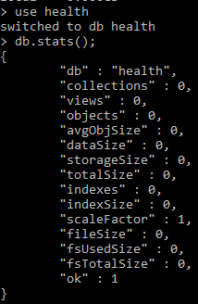
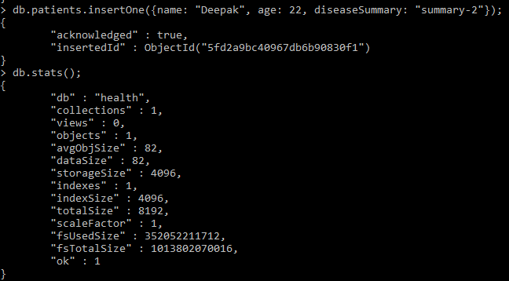
Stats() before & after inserting Document.

Slide 4

Display using variable To find datatype of variable

Slide 5
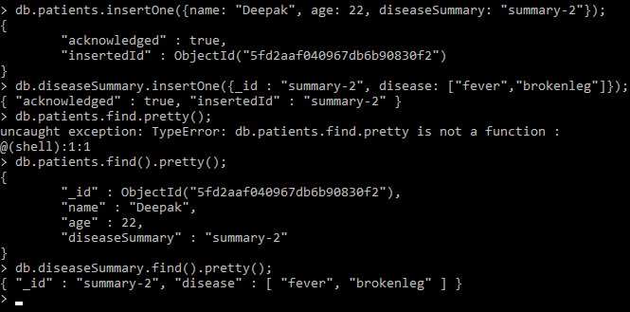
Patient-Disease Relationship (one - one)

Slide 6
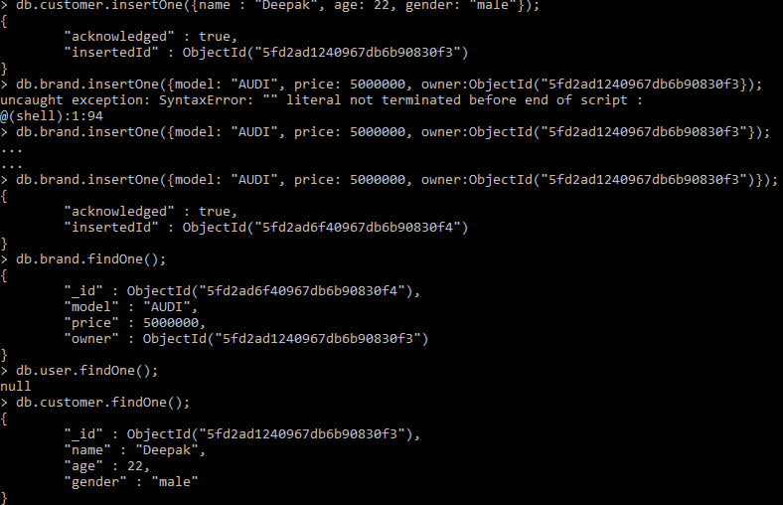
Customer-Car Relationship (One - One)

Slide 7
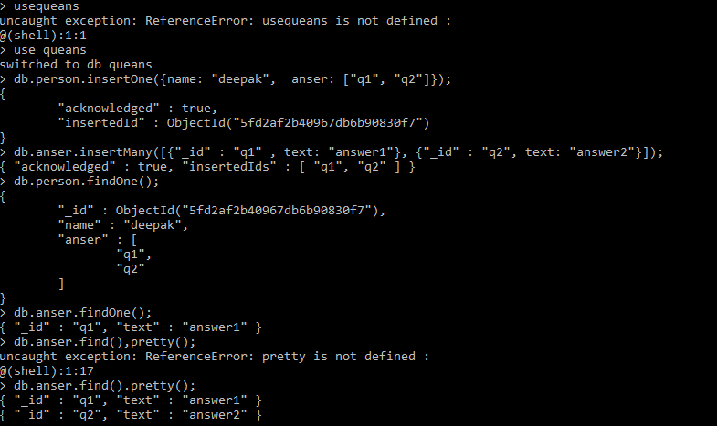
Question – Answer Relationship (One - Many)

Slide 8
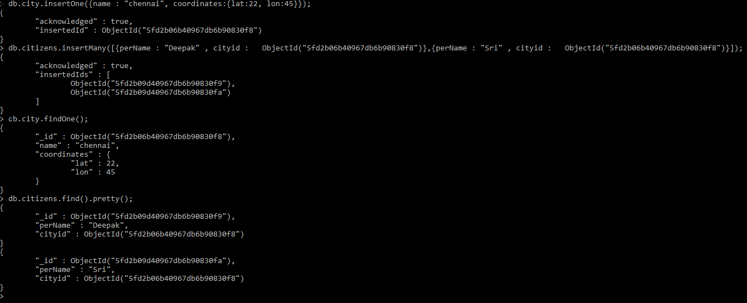
City – Citizens Relationship (One - Many)

Slide 9
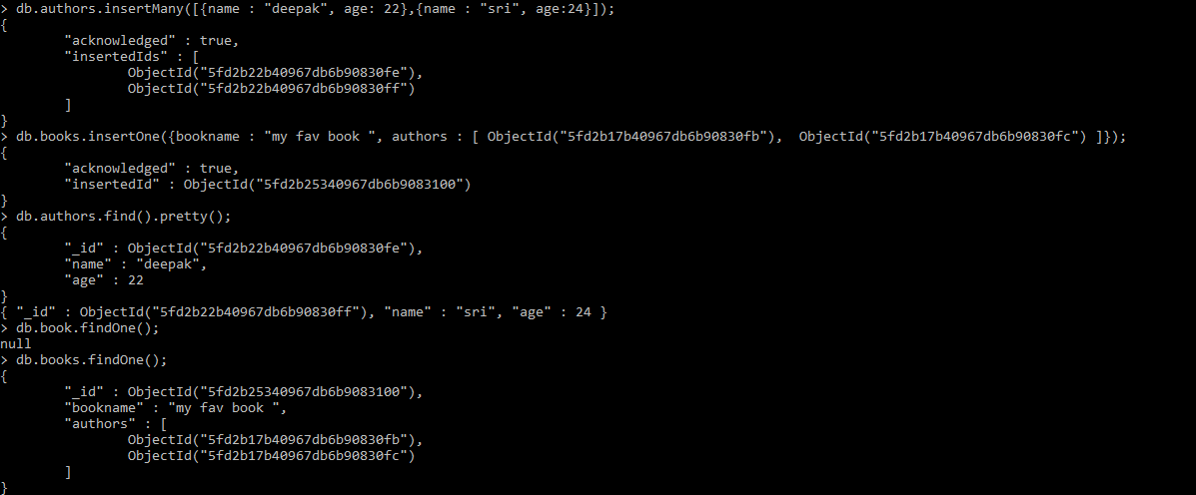
Books – Authors Relationship (Many - One)

Slide 10
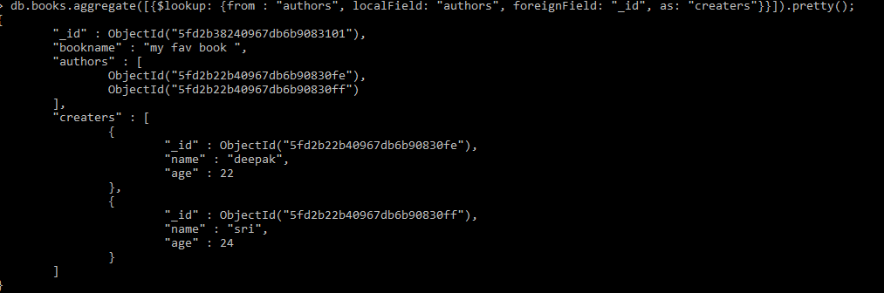
Books – Author (Aggregate)

Slide 11
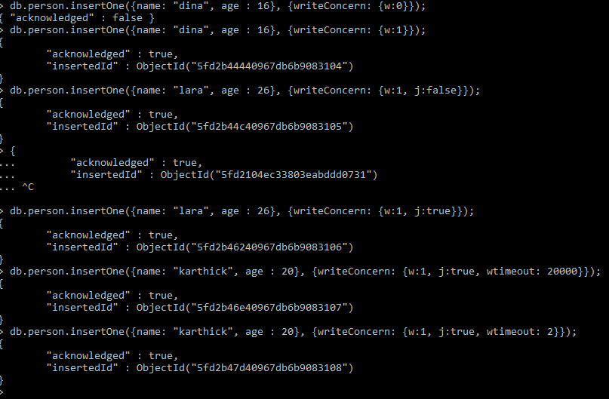
Write Concern

Slide 12
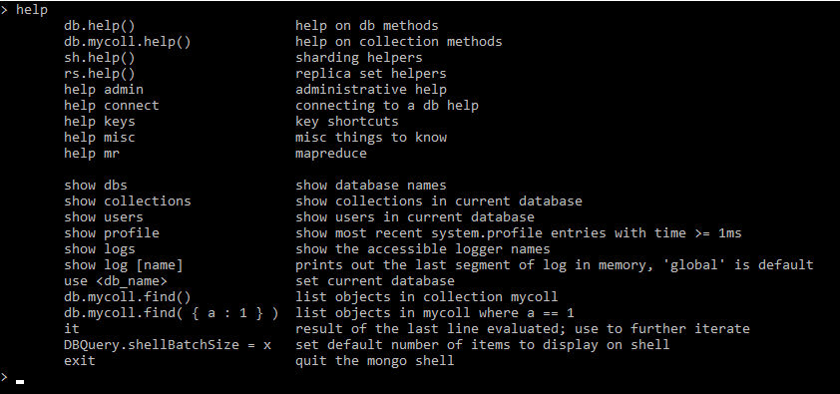
Help

Slide 13
Collection help Database methods Admin help
Collection help:
db.collectionname.help();
Database methods:
db.help();
Admin help:
Help admin;

